Slide 1

Carthago Display
Sprint Review #3

Slide 2
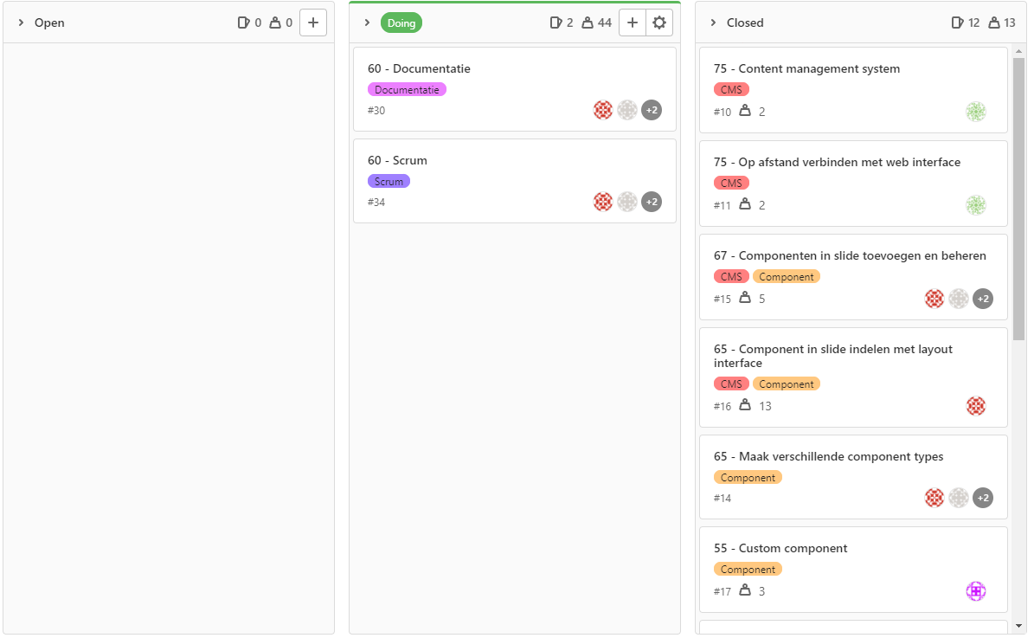

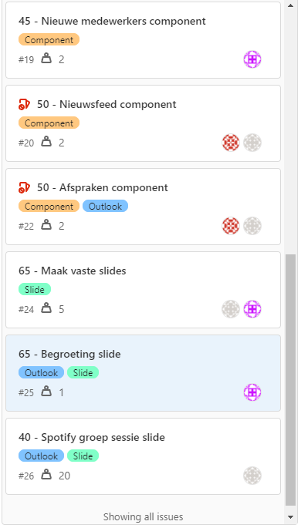
User Stories: Sprint #3

Slide 3
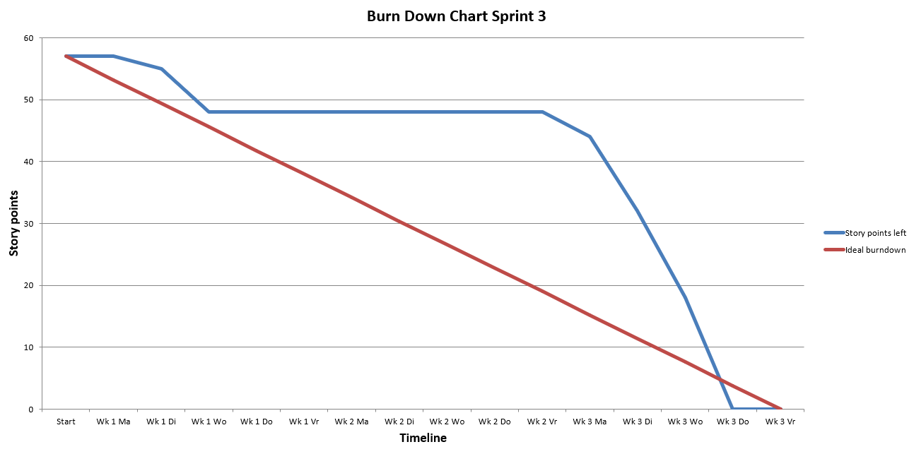
Burn Down Chart: Sprint #3
57 scrum points burned.
37 issues in productbacklog.

Slide 4
DEMO

Slide 5
TERUGBLIK

Slide 6

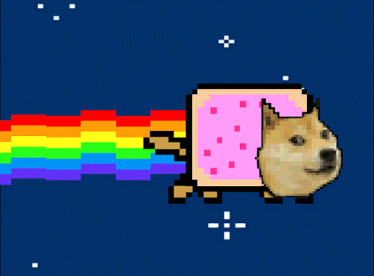
Vragen?

